Slide 1

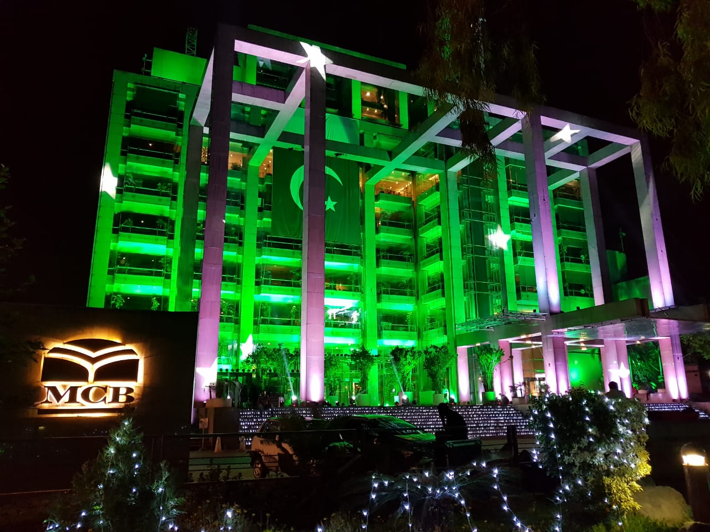
Muslim Commercial Bank (MCB)
GROUP MEMBERS:
ASJID TAHIR IBRAR BABAR UMAR KHOG KHAN USMAN MANZOOR

Slide 2
HISTORY
MCB Bank Limited was incorporated by the Adam jee Group on July 9,1947 , as a limited Company
The Bank was nationalized in 1974 during the Govt of Zulfiqar Ali Bhutto.
This was the first Bank to be privatized in 1991.
The president of the Bank is M.U.A Usmani.
The current president of the Bank is Mr.Imran Maqbool.

Slide 3
MCB is one of the leading Bank of Pakistan with a
deposit base of about Rs.280 billion.
Total assets of around Rs.300 billion.
The bank has a Customer base of Approximately 4 million.
Nation wide distribution network of 1200 Functional branches.
Branches in Foreign Countries
Over 720 ATMs in the market.

Slide 4

To be the leading financial services provider.
Partnering with our customer for a more prosperious and secure future.

Slide 5
Planning Structure:
Stakeholders
Leading Structure.
Controlling Structure.

Slide 6
Controlling structure:
Financial, managerial and operating information is accurate, reliable and timely.
Policies, standards, procedures and applicable laws & regulations
Assets of MCB Bank Ltd. are adequately safeguarded.
Quality and continuous improvement are fostered into control processes.

Slide 7

Human Resource Management:
Strong HRM is key input for work everywhere
and in MCB it is vital
Recruitment and selection takeplace by HR Department
only.
After hiring new recruits they are trained
Via lectures and three month work at different branches.

Slide 8
Approaches to Management
Scientific Management
General Administrative theory
Quantitative Management
Contingency approach

Slide 9
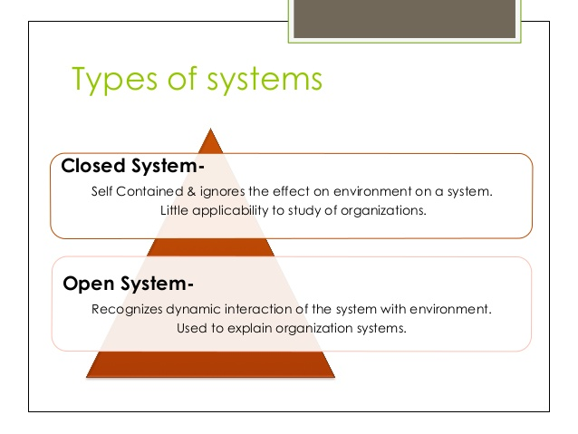
System approach

Slide 10
Culture:
Bank creates culture through socialization and training staff to view customers and customers interactions in specific ways.
Banks creates a kind of person consistent with the culture of the bank through rites and rituals.
Maintaining a specific culture drives the ability to shape and direct customer and employee interactions in targeted and expected ways.

Slide 11
How does Culture affect banking?
Culture drives behavior.
Culture has significant implications for all critical aspects of a community bank's operations.
Including the way the bank will lend and how it will treat its Customers, and the bank's role in the communities it serves.
Culture will evolve, especially as a bank faces new challenges.

Slide 12
CSR:
MCB Bank, as one of the largest Banks in Pakistan, has a rich legacy of service and innovation spanning over 72 years.
The Bank continuously strives to adopt the best practices and encourages a culture of discipline and values for its stakeholders. By initiating projects and services that function in a socially responsible way.
MCB Bank ensures environmental sustainability and the social well-being of its employees and the society at large.

Slide 13
Shareholding Report 2019:
Description | Shares held | Percentage
Directors, Chief Executive Officer, and their Spouses and Minor Children | 119,605,330 | 10.0928%
Associated Companies, Undertakings and Related Parties | 215,730,246 | 18.2042%
Banks, Development Financial Institutions, Non-Banking Financial Institutions | 16,218,227 | 1.3686%
Insurance Companies | 100,220,314 | 8.4570%

Slide 14
Funds | 7,455,211 | 0.6291%
Shareholders Holding 10% | 222,606,147 | 18.7844%
General Public (Local) | 134,139,330 | 11.3192%
General Public (Foreign) | 3,132,548 | 0.2643%
Others | 365,951,741 | 30.8804%
Total | 1,185,060,006 | 100.0000%

Slide 15
Ethical Values:
MCB Bank’s Vision is to be the leading financial services provider, partnering with customers for a more prosperous and secure future. To achieve this vision, the Board of Directors sets strategic aims of the Bank and provides leadership to our members.
Ethical Conduct:
The financial services industry in which MCB Bank operates is built on the highest levels of trust. Integrity is a cornerstone of the business. Directors shall act on behalf of the Bank with professionalism, honesty and integrity as well as high moral and ethical standards.

Slide 16
Decision making Process:
Presentation of the Staff Projection.
The Major Briefing.
Final Policy Recommendations.
Deliberation and Decision.
Publication and Communication.
Final decision.

Slide 17
Strategic Goals of MCB Bank:
Core Values
Integrity. We are the trustees of public funds and serve our community with integrity.
Innovation.
Excellence.
Respect.

Slide 18
Management Process:
Planning is also a management process
Top level Manager actually do planning for organization
Planning is actually do to achieve goals for organization.
Leading: Top level managers and branch heads lead their work.
Working: Whole team works.

Slide 19
Strategic management
External Analysis:
The company allows for self-growth with entrepreneurial opportunities to its employees.
There are no threats in terms of competition since the service provided is so niche.
Internal Analysis:
Resources needed include labor and equipment, which is easy to obtain.
There is no real shortage of labor due to the salary package provided and hence the need for a rigorous recruitment process.

Slide 20
Strategic management
Vision:
Provide the best value proposition in Global Business Process Outsourcing services.
Deliver the best in quality, customer experience, growth and sustainability.
Mission:
Provide the clients on-going value and success.
Create synergies and strategic business alignments to empower clients and employees alike.

Slide 21

Organizational structure:
An organizational structure is a system that
outlines how certain activities are directed in
order to achieve the goals of an organization.

Slide 22
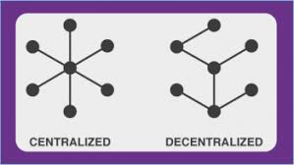
Organization type
Centralization Organization
(Small businesses often use this
structure.)
Decentralization Organization.
Our organization use decentralization structure.
(Decentralized organizations rely on a team environment at different levels.)

Slide 23
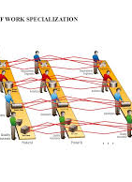
Work Specialization:
Employees specialize in individual tasks.
Manager divide the work to employees.
Employees can get work according to their quantity.
Employees do the best as they have learned in
training how to do hard work.
Employees become more efficient.

Slide 24

Departmentalization & Span of control
As an organization grows,
its departments grow and more sub-units are created,
which in turn add more levels of management.
Span of Control of our organization is narrow.

Slide 25
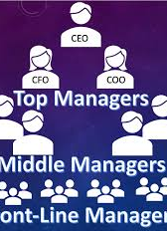
Chain of command
Upper management or vise president report CEO.
Department managers or supervisors report higher
level executives.
First line workers report the manager of branch

Slide 26
Structure type:
Simple structure
(New company use this structure.)
Functional structure
(Organizations b/w small and middle use this structure.)
Divisional structure
(Large organizations like MCB use this structure.)

Slide 27
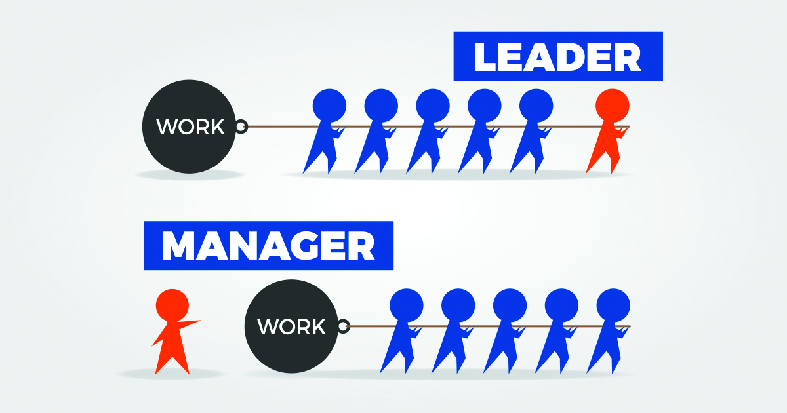
Leadership:
Leadership in our organization is under branch manager.
Manage all internal and external expects of branch.
Manage environment.
Manage Staff.
Interaction with customers.
Deposit cash.

Slide 28
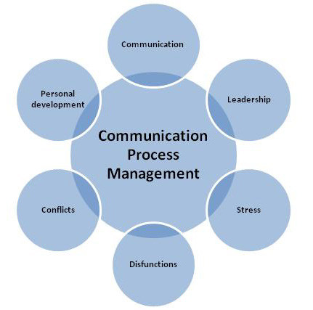
Communication:
Better understanding between all Branches.
Offices open for all suggestions and feedback.
Communication b/w manager and employee is good.
By efficient communication b/w OM & Employees, the Environment become more productive.
Their service become more efficient.

Slide 29
Any Queries???
Students: “NO!!!!”
Okay ThankYou!!!

